Slide 1

Demonstration for mid review
By kieron underwood

Slide 2
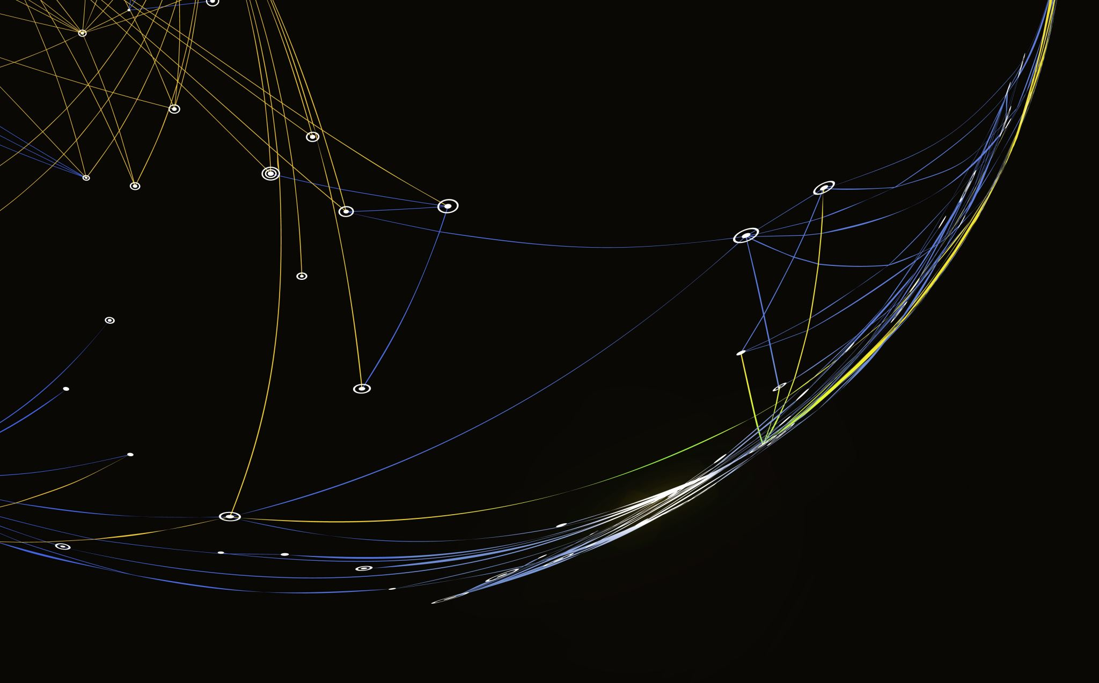
What has been done?

Slide 3
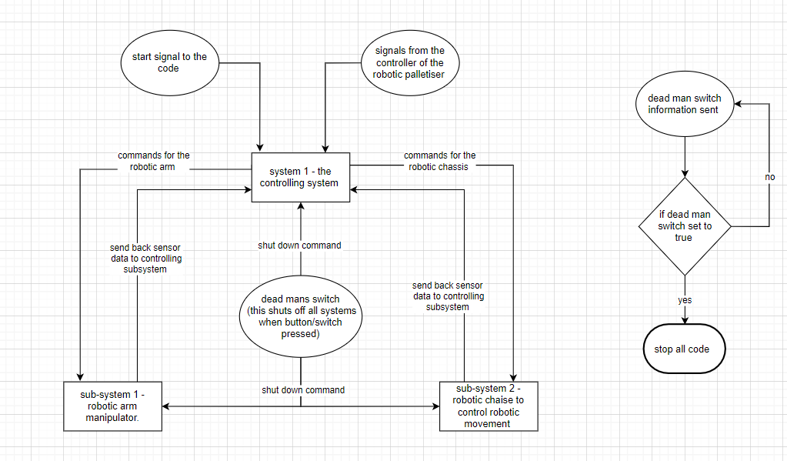
Diagram of the communication flow of the robot and the switch-off command for the Deadman switch.

Slide 4
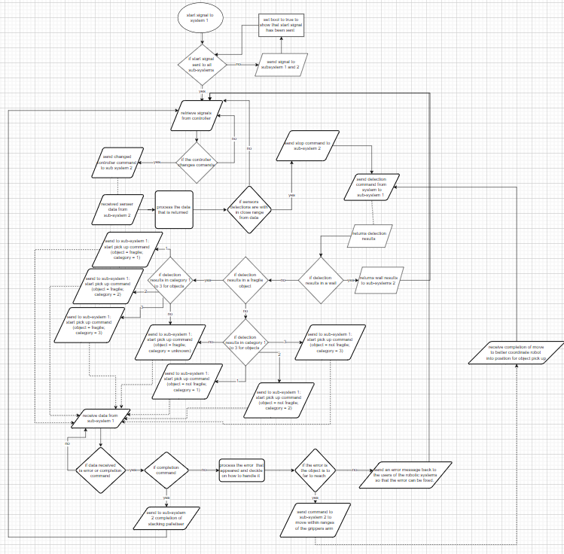
Flow chart of command structure of system 1
This is the main system flow chart.
The first part is used by receiving the command from the controller for movement.
It sends the command to subsystem 2 to work on that until a confirmation command is returned.
After that it checks if subsystem 2 ultrasonic sensors detected anything if it has then it moves on to more detection methods.
by sending signals to subsystem 1 which then sends back the categorization of the block which is then sent back to the same system to move the object and place it in the correct position.
The last part is for taking in the completion form the subsystems and any error message that comes up and how the system deals with it.

Slide 5
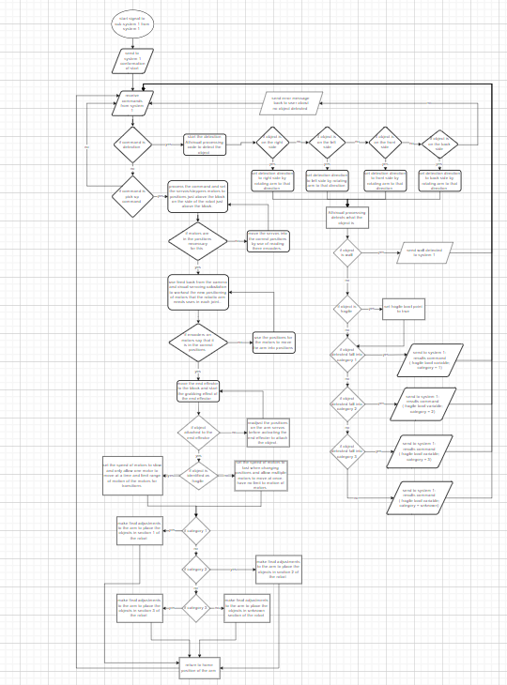
Flow chart for the sub-system 1
This is the flow chart for the arm code that has been made
first if statement detects if the command for detection is given if yes then it goes down the detection path of the flow chart
The second direction is the flow chart for picking up and placing the object into the correct position.

Slide 6
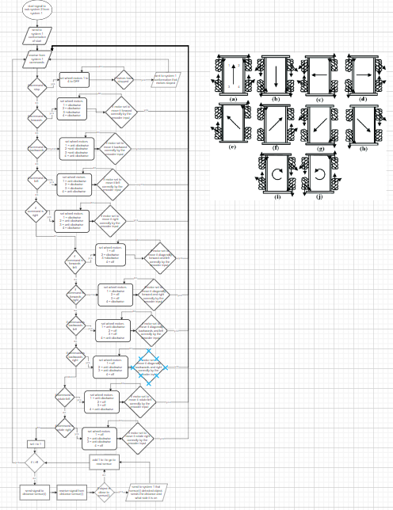
Flow chart for sub system 2
This is the flow chart for the chassis of the robot
It gives a function concepts for motion using omnidirectional wheels
It also has code for the stopping of the robot.
The last part of this is that of the sensors which the flow chart goes over the repeating of the detection methods using ultrasonic sensors.

Slide 7
Other completed/in progress of completion
Setting up the base software that was needed to achieve the results.
DH frames code from MATLAB scripts into Python code
Transitions matrix from DH parameters for forward kinematic
Making a Jacobian matrix for the inverse kinematics of the DH frames.
Research into visual servoing

Slide 8
Any problems that have come up?

Slide 9
The problems that I have faced so far.
Trying to understand the complicated math for visual servoing.
Refreshing the understanding of DH frames and applying it to the Nyiro Ned robotic arm.
At the beginning of this project understanding what to do and when to have it done.
The solution to the previous problem was after the planning stage of the project and the implementation of a well-structured Trello board that the task for each member is updated for each week when it is planned to be done.
Timing around the deadlines of other assignments because I tend to focus on them rather than this assignment and project.
Write up in a legible format for my part

Slide 10
What will be done in the future?

Slide 11
Plans to be completed.
Visual servoing research
Deciding by the 12th Jan whether to continue with visual servoing or entertain using an alternative method
finish DH frames.
Start implementation of the camera images into code for processing either by visual servoing or other methods that are decided on after the 12th Jan
Complete the implementation of all code together for the robot.

Slide 12
Any pit falls that I can see coming up?

Slide 13
Future problems that I can see
The integration stage is going to be the part that is the most likely to fail
Concentrating on this work around deadlines for other modules
Write up in a legible format for my part

Slide 14
Any questions?

